Slide 1




Scripting
Prof. Darrell Long
CSE 13S

Slide 2


Scripting lets the lazy be productive
Operates on higher level objects
Files
Processes
The Software Tools Philosophy lets us:
Connect the output of one program to the input of another program.
This is program composition (like $(f∘g∘h)(x)$ from mathematics).

Slide 3

Who are you calling lazy?
Smart programmers reuse code, programs, components.
If I can use sort to sort a file, why should I rewrite it?
If I can use sed to make edits in a file, why should I write an editor?
If I can use grep to find all regular expressions in a file, …
If I can use awk to parse a file, …

Slide 4

From sh to zsh
sh was the original Unix shell:
Called the Bourne shell, after Stephen Bourne
There are many shells
csh, tcsh, bash, zsh, …
You can write your own!

Slide 5
BASH
The Bourne Again Shell
Written by Brian Fox as a replacement for the Bourne shell.
Shells:
Act as command interpreters.
Allows users to give commands to the OS either…
Interactively: as a prompt or command line (typically indicated with a $)
Batched: as a script (a file containing a sequence of commands)

Slide 6
Commands
Bash reads some input (usually a terminal or a file) line-by-line.
Each line is treated as an entire command.
Each line is split into different tokens, or words, by whitespace.
The first word on a line is the command to execute, with the following words the arguments for the command.
Example:
$ ls -a
ls is the command to list files.
-a is an argument to ls that tell it to list files prefixed with a . (dot).

Slide 7
Types of commands
Aliases
Only used in interactive shells.
Aliases are replaced with what they are aliasing before a command is executed
e.g. if ll is an alias for ls -l, then ll is replaced with ls -l before being executed interactively.
Builtins
Bash-provided commands, such as printf, echo, and cd.
Functions
A sequence of commands that perform some task.
Bash functions can accept arguments.
Executables
Executable programs are specified and executed by file path.
Or just by their respective names if the directory they’re contained in are in the $PATH environment variable (more on this soon).

Slide 8
$PATH
A colon-delimited list of directory names.
These directories indicate where executable programs are located.
Directories typically included in $PATH:
/bin – For commands required by system for repairs and booting.
/usr/bin – Primary directory of executables on the system.
The current directory . should not be included in your $PATH for security.
Which is why executing your own programs typically requires a relative path.
$ ./hello

Slide 9
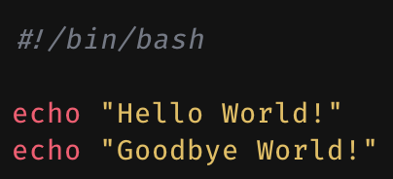
Writing a script
A script is a sequence of commands in a file (usually made executable).
The first line of a Bash script should be the interpreter directive.
Also referred to as a hashbang or a shebang.
Indicates which interpreter to interpret the script with.
#!/bin/bash – Interpret script using /bin/bash.

Slide 10
Basic dotfiles
Dotfiles are files prefixed with a dot (.) that sit in your home directory.
There are 2 that directly relate with Bash (there are variants for different shells):
.bashrc
.bash_profile
.bashrc is a script that is executed whenever Bash is started interactively.
Commands that should be run every time a new interactive shell is started go here.
Such as customized shell prompts, aliases, etc.
.bash_profile is also a script, but is executed only at the start of a new login shell.
Commands that should only be run once should be put in here.
Example: modifying/exporting the $PATH environment variable.

Slide 11
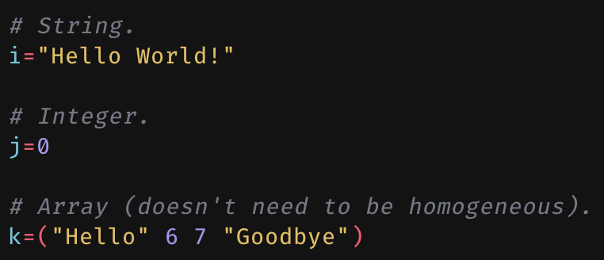
Parameters & Variables
Used to store data.
A variable is a kind of parameter.
The fact that a variable has a name is the distinguishing factor.
Variable names can only consist of letters, digits, and underscores, and only start with either a letter or an underscore.
Assign data using the assignment operator: =.
Cannot use spaces around = in an assignment.
Variables can be strings, integers, or arrays.

Slide 12
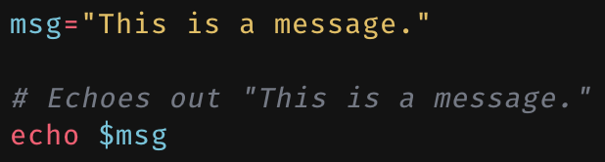
Expansion
Can expand parameters using the expansion operator: $.
Variable expansion substitutes the variable with its value.

Slide 13
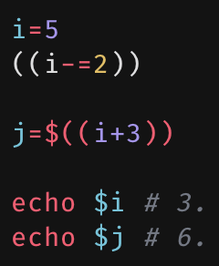
Arithmetic
Arithmetic expressions are performed in (( … )).
The result of these expressions can be expanded with $(( … )).
Some arithmetic operators (non-exhaustive):
var++, var--
++var, --var
+, -, *, /, %
<, <=, =, !=, >=, >
&, ^, |, <<, >>
+=, -=, *=, /=, %=

Slide 14
Special Parameters
Variables are named parameters.
Special parameters are parameters that are not variables.
Examples:
$n - The n-th argument passed to the current script or function (these are positional parameters).
Use curly braces if n has more than one digit: ${10}.
$# - The number of positional parameters.
$$ - the process ID (PID) of the current shell.
$_ - The last argument of the last executed command.
$? - Exit status of last executed command.

Slide 15
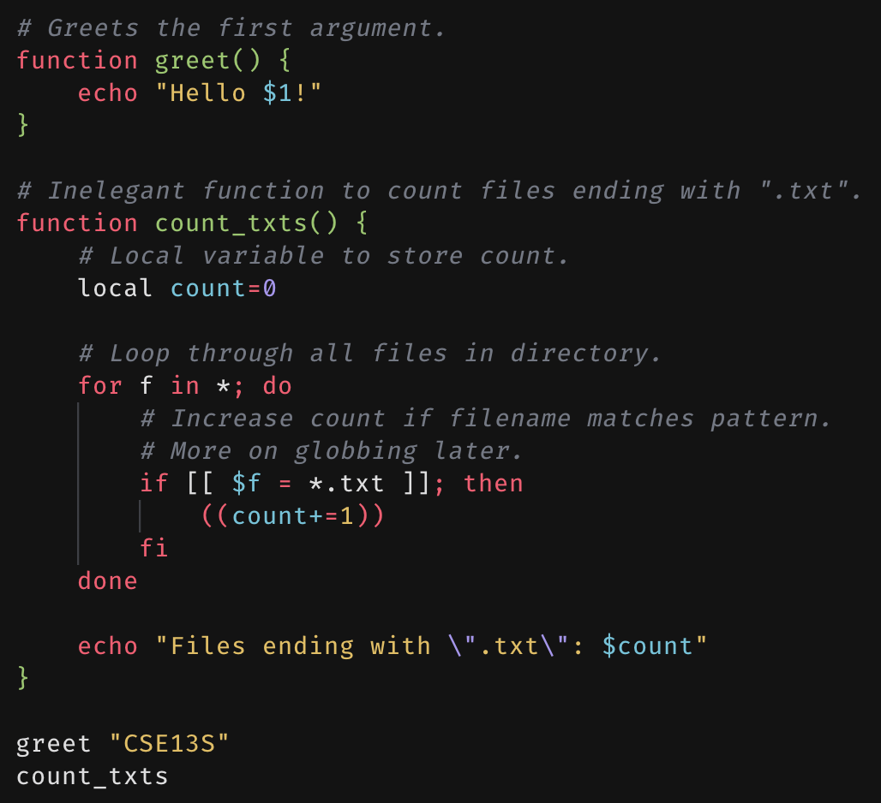
Functions
Sequences of commands.
Can have multiple functions within one script.
Allows for local variables.
Prevents issue of overwriting variables from the function caller’s scope.

Slide 16
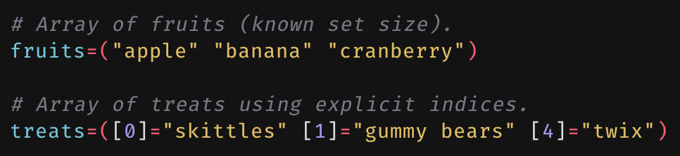
Arrays
An array is a list of strings (yes, it maps integers to strings).
Most simply created using the arr=(…).
Bash allows for arrays created using explicit indices for more flexibility.
Arrays with gaps between indices are sparse arrays.

Slide 17
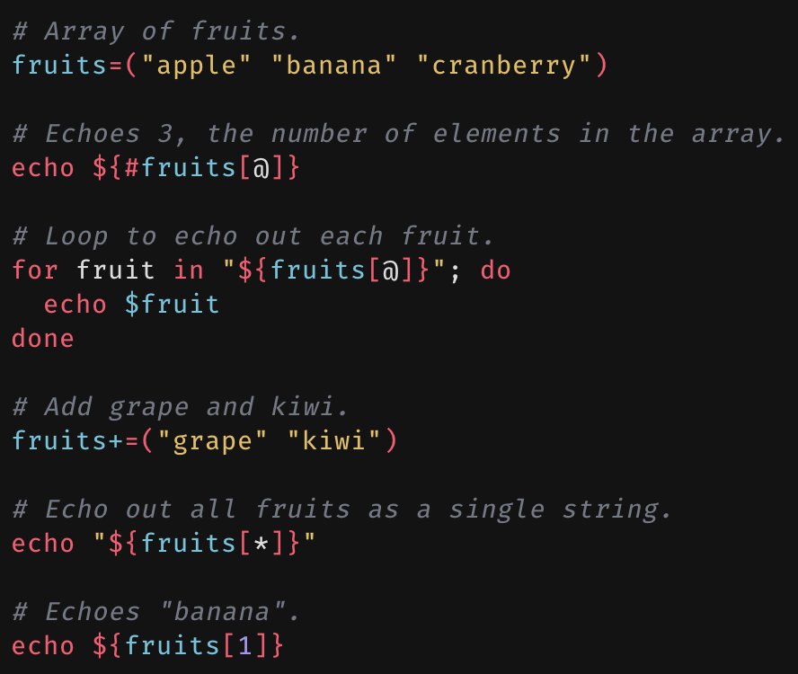
More on arrays
Expanding specific array indices:
${arr[n]}
Getting the number of elements of an array:
${#arr[@]}
Expanding array to list of words:
“${arr[@]}”
Expanding array as a single string:
“${arr[*]}”
Appending array with another array:
+= ( … )
Expanding n-th index of array:
${arr[n]}

Slide 18
Globs & Patterns
Globs: patterns used to match strings.
* - matches any string including the null (empty) string.
$ ls *.c (matches anything that ends with “.c”)
? - matches any single character.
[chars] - matches any character in chars
[a-z] - matches any character between a and z
Echo names of text files, JPEGs, and PDFs:
echo *.{txt,jpeg,pdf}

Slide 19
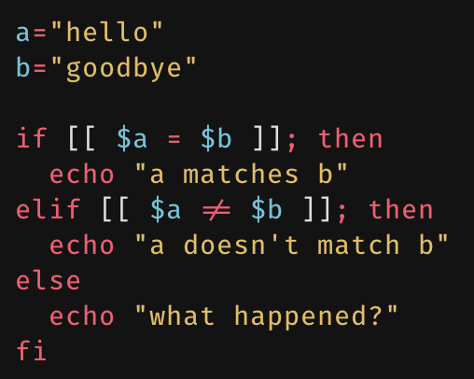
Testing & Conditionals
The logical operators that appear in C appear here in Bash as well:
&& – logical AND
|| – logical OR
! – logical NOT
Equality is tested using = (not == as is used in C).
There are also if, elif, and else blocks.
Conditional blocks must end with fi.
Tests are done within [[ … ]].
Can also use [ … ], but it’s older and lacks features such as pattern matching.
Use [ … ] if the script may be run in an environment without Bash.

Slide 20
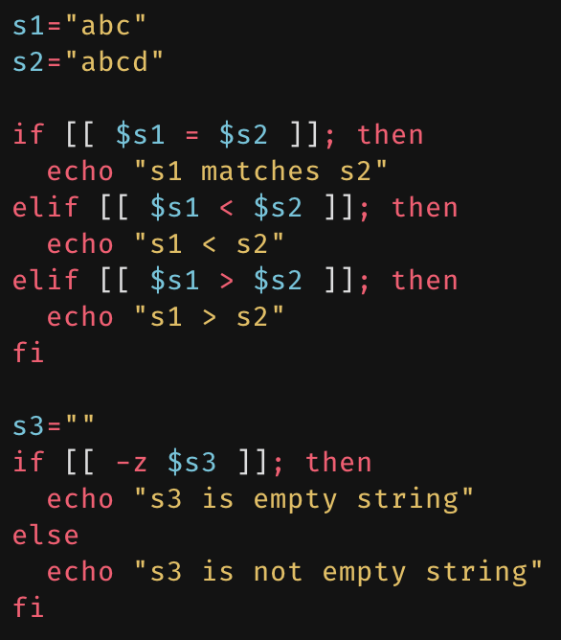
Testing (strings)
Tests on strings:
$s1 = $s2 (s1 match s2?)
$s1 != $s2 (s1 doesn’t match s2?)
$s1 < $s2 (s1 lexicographically less than s2?)
$s1 > $s2 (s2 lexicographically greater than s2?)
-z $s (is s an empty string?)
-n $s (is s not an empty string?)

Slide 21
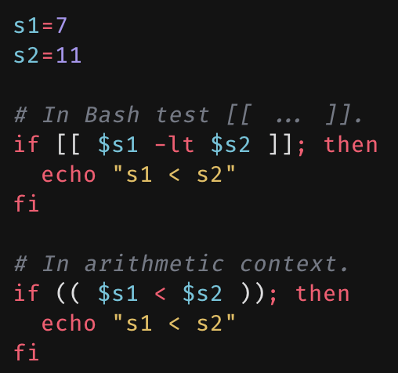
Testing (integers)
Tests on integers:
$x -lt $y ($x < $y)
$x -le $y ($x <= $y)
$x -eq $y ($x = $y)
$x -ne $y ($x != $y)
$x -ge $y ($x >= $y)
$x -gt $y ($x > $y)
Can also test integers in arithmetic contexts.
Between (( … ))

Slide 22
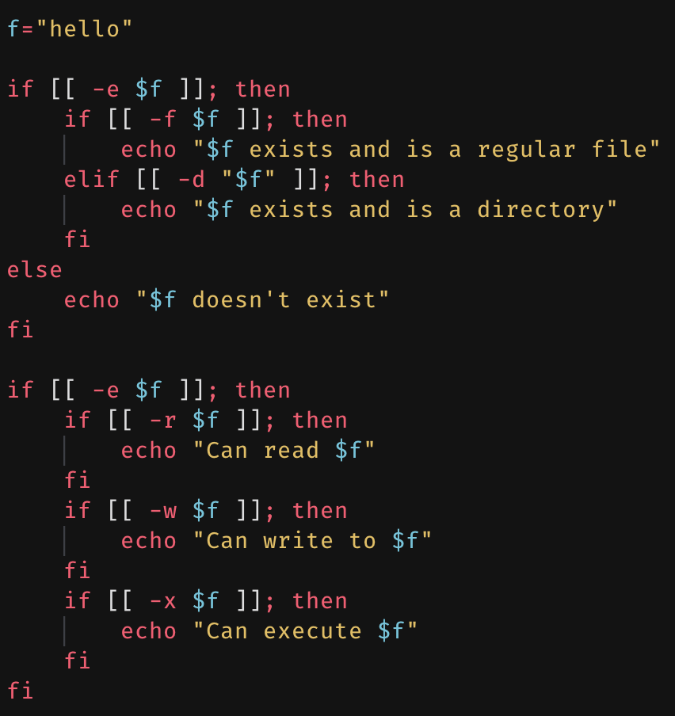
Testing (files)
Tests pertaining to files:
-f $file (is $file a regular file?)
-d $file (is $file a directory?)
-e $file (does $file exist?)
-r $file (can user read $file?)
-w $file (can user write to $file?)
-x $file (can user execute $file?)

Slide 23
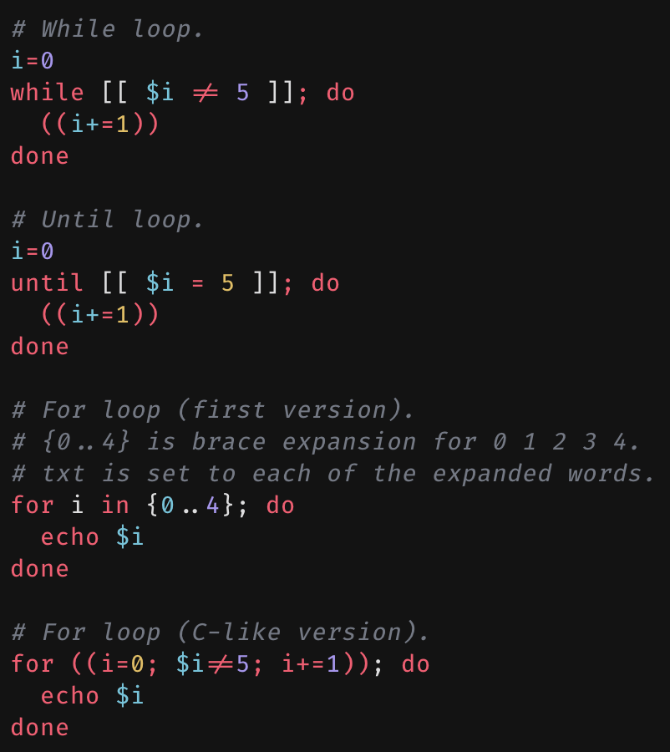
Loops
Four different loop syntaxes in Bash:
While
Loop while condition is true.
Until
Loop until condition is true.
for win word
Loop for each word of words, setting w as each word.
for ((init; cond; incr))
Loop starting with the init expression, while the cond expression is true, and incrementing with the incr expression after each loop body execution.

Slide 24
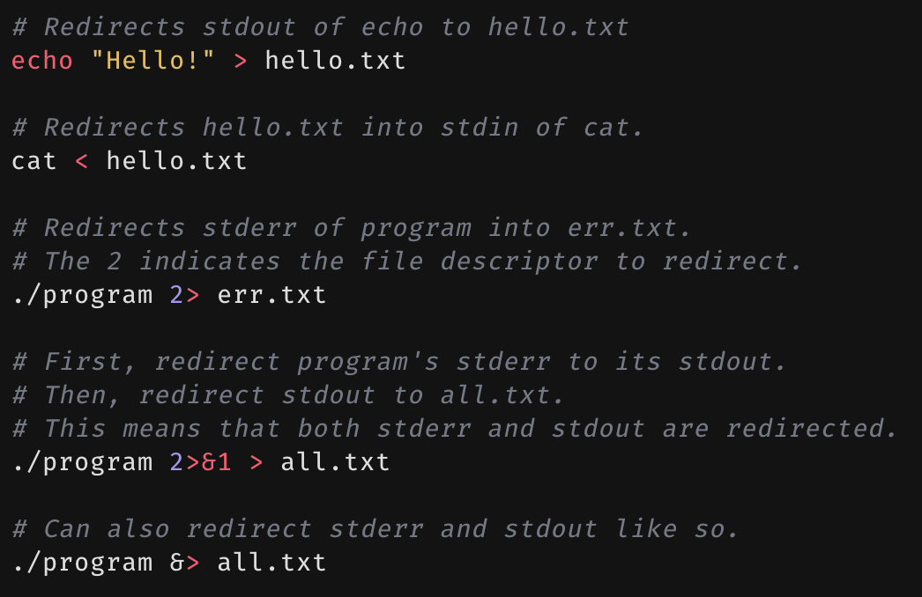
File redirection
Each process on UNIX has access to the following file descriptors:
stdin - standard input
File descriptor 0
stdout - standard output
File descriptor 1
stderr - standard error
File descriptor 2
These file descriptors can be redirected from or to files.

Slide 25

Pipes
Connects stdout of one process to stdin of another process.
Pipes are denoted with the pipe operator: “|”.
Pipes can be chained together, creating a pipeline.
Programs can be written such that they can be chained together to get interesting results.
The whole philosophy behind the software tools that drives UNIX.
Example pipeline: list the IDs of the user’s processes (limit to 10).
ps aux | grep $USER | awk ‘{ print $2 }’ | head
What’s awk?
Brian Kernighan

Slide 26

Why is called awk?
awk is a program for simple parsing of text.
It follows the Software Tools Philosophy.
It is named after:
Albert Aho (a)
Peter Weinberger (w)
Brian Kernighan (k)
My friend PJW

Slide 27
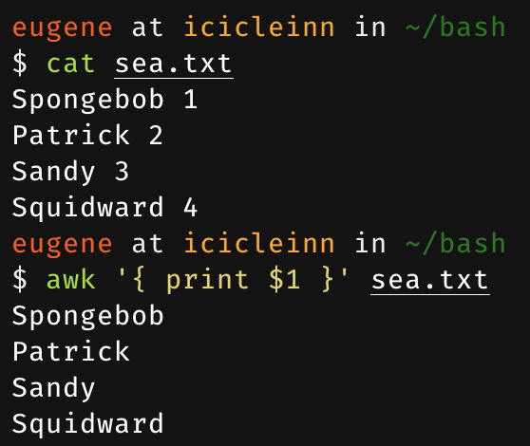
awk
Developed by Alfred Aho, Peter J. Weinberger, and Brian Kernighan.
Designed as a text processor that scans input files, splitting input lines into fields automatically.
Output from awk can be processed even further with other tools.
Such as with sort, or uniq.
All thanks to the UNIX software philosophy.

Slide 28
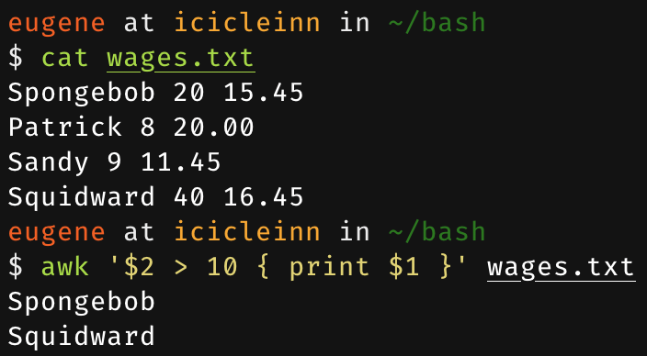
A simple awk program
A simple awk program is a sequence of pattern-action statements:
Written as:
awk ‘pattern { action }’
Patterns are optional.
Suppose we have a file of workers containing their names, the hours they worked for the week, and their hourly wage.
How would we process the file to only display the names of the workers who worked more than 10 hours during the week?

Slide 29
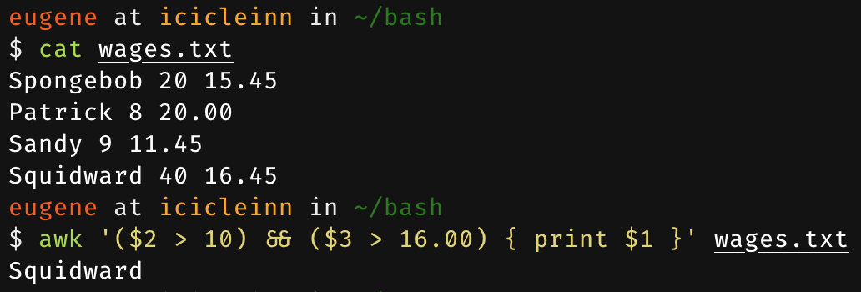
More advanced patterns
Patterns in awk can be combined (or even constructed using regular expressions).
Combined using parentheses and logical operators:
&& – logical AND
|| – logical OR
! – logical NOT
Using the same wage file as before, we want the names of the workers who worked at least 10 hours and make at least $16 an hour.

Slide 30
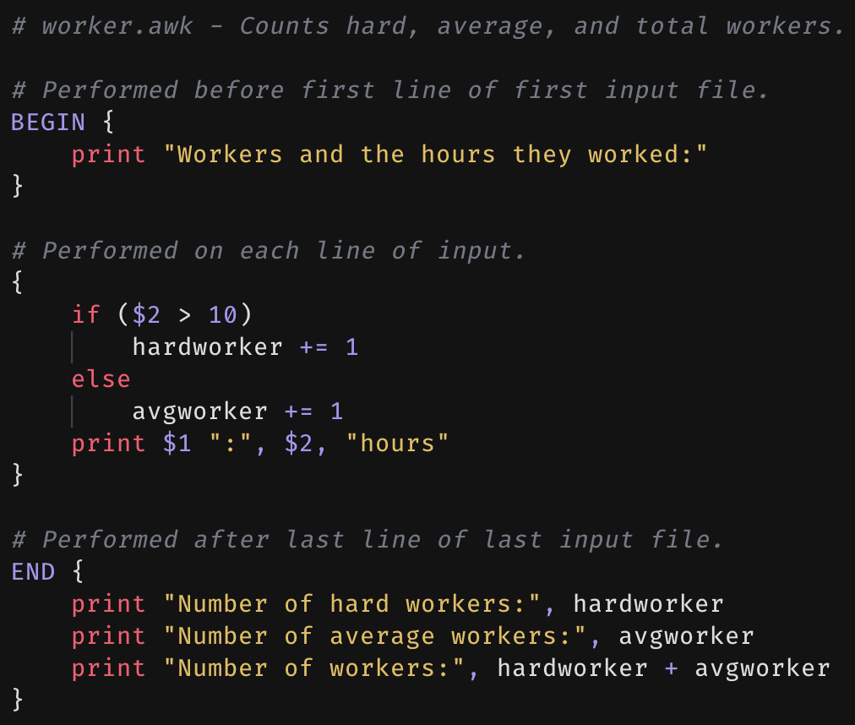
Larger awk programs
awk is capable of much more than the simple text processing seen so far.
Can write full-fledged programs in awk.
Here’s a simple program that counts the number of workers that worked more than 10 hours and less than 10 hours:
Uses BEGIN, and END, as well as if-else conditions.
Also makes use of variables.
User-created variables in awk aren’t declared.
Run as:
$ awk -f worker.awk wages.txt

Slide 31
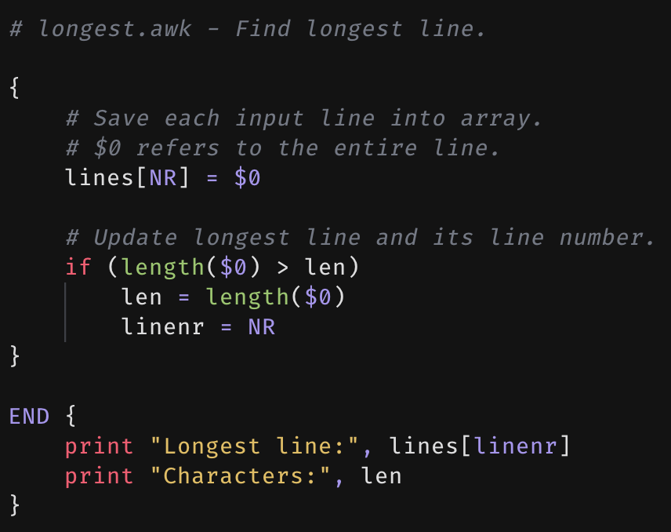
Another awk example
Another sample awk program to find and print out the longest line in some input.
Makes use of:
Arrays
Built-in functions:
length(x): calculates length in characters of x.
Built-in variables:
NR: holds the number of lines currently read.

Slide 32
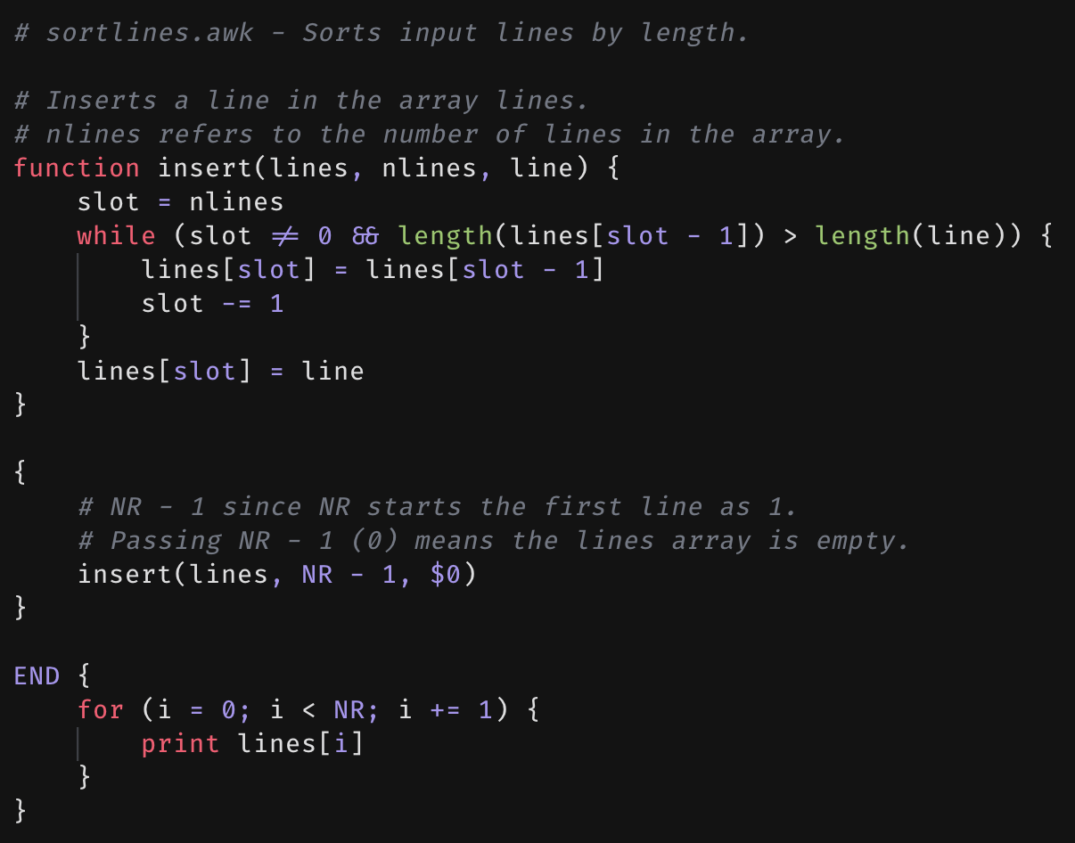
One last awk example
Sorts input lines by increasing length.
Makes use of
Arrays
Functions
Can accept parameters
Can return values
Loops (while/for)
Syntax of loops matches C-style loops.

Slide 33
Useful commands
diff – compare files line by line
tee – copies stdin to stdout, copying the read contents to 0 or more files
sort – sort or merge lines of files
uniq – report or filter out duplicate lines in a file
wc – report word, line, character, and/or byte count
mv – move (or renames) a file
cp – copy a file
rm – remove a file

